Slide 1




Web
&
Internet
Class V
lab 12

Slide 2


Customizing Chrome
A web browser is a type of software that allows you to find and view websites on the Internet

Slide 3
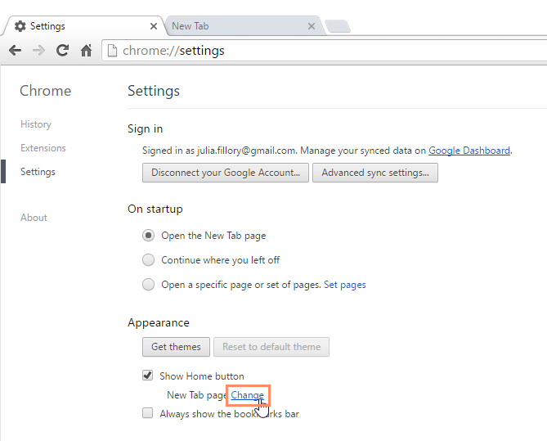
Home Page
If you'd like to see a specific website each time you open your browser you can set one

Slide 4
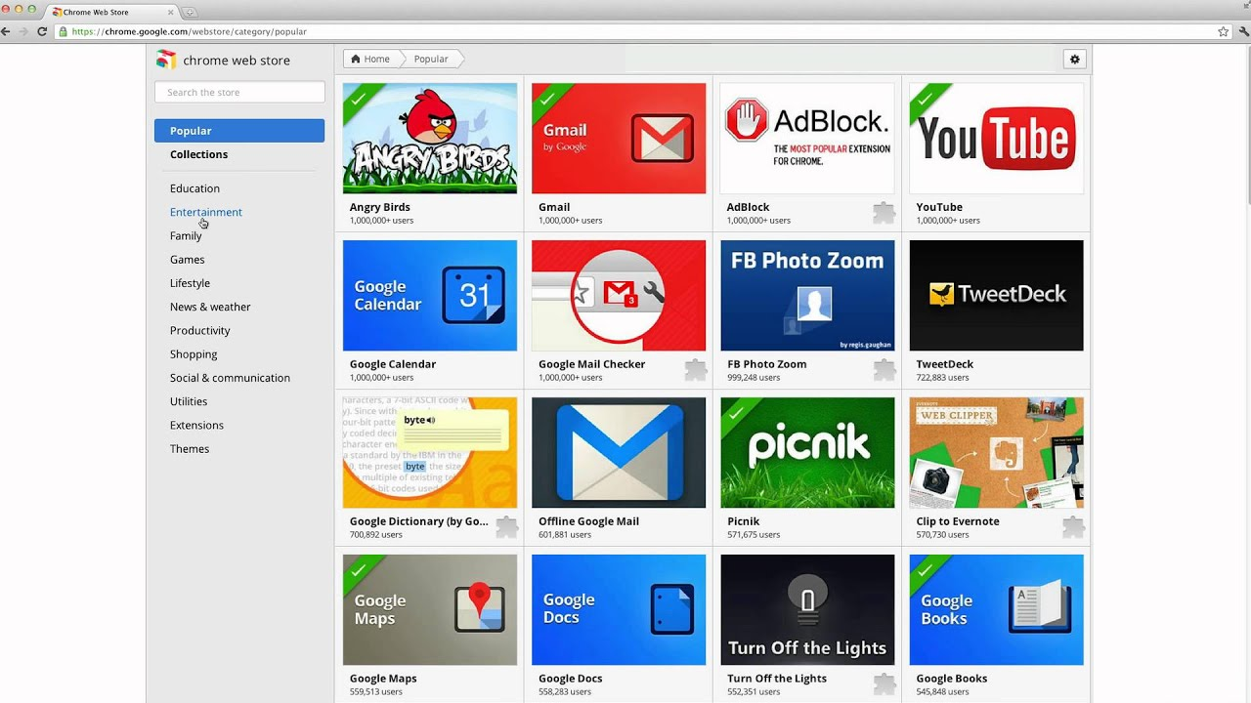
Chrome Web Store
The Chrome Web Store allows you to download different web apps, extensions, and themes

Slide 5


